Slide 1
Bitwise Operation
位运算

Slide 2
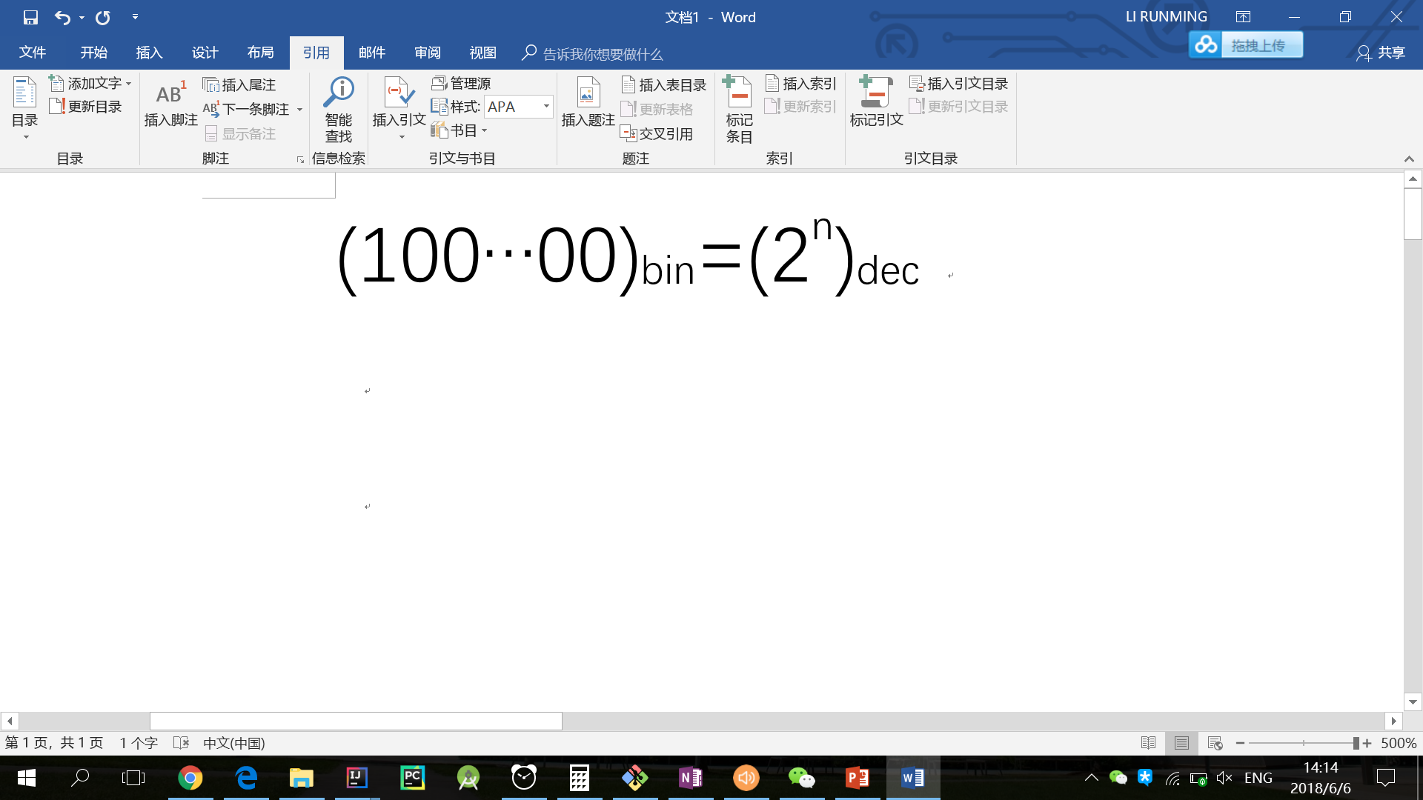
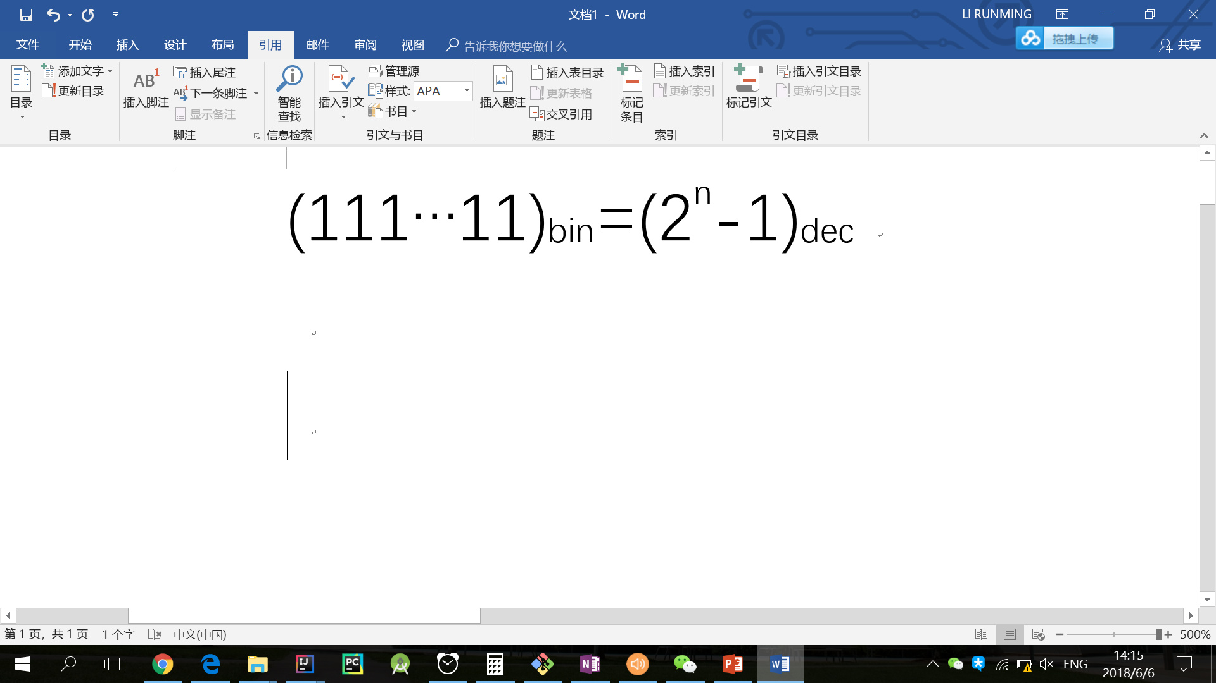
二进制转换十进制
特殊地

Slide 3
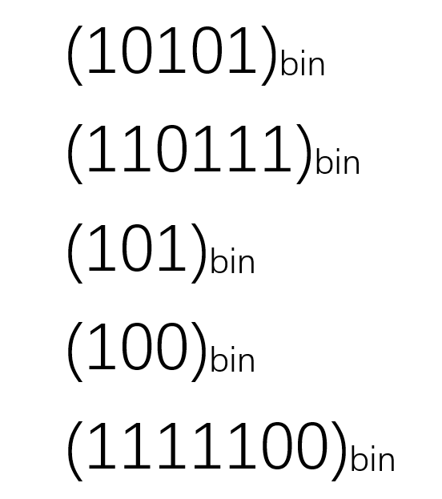
Practice
Notes:
21
55
5
4
124

Slide 4
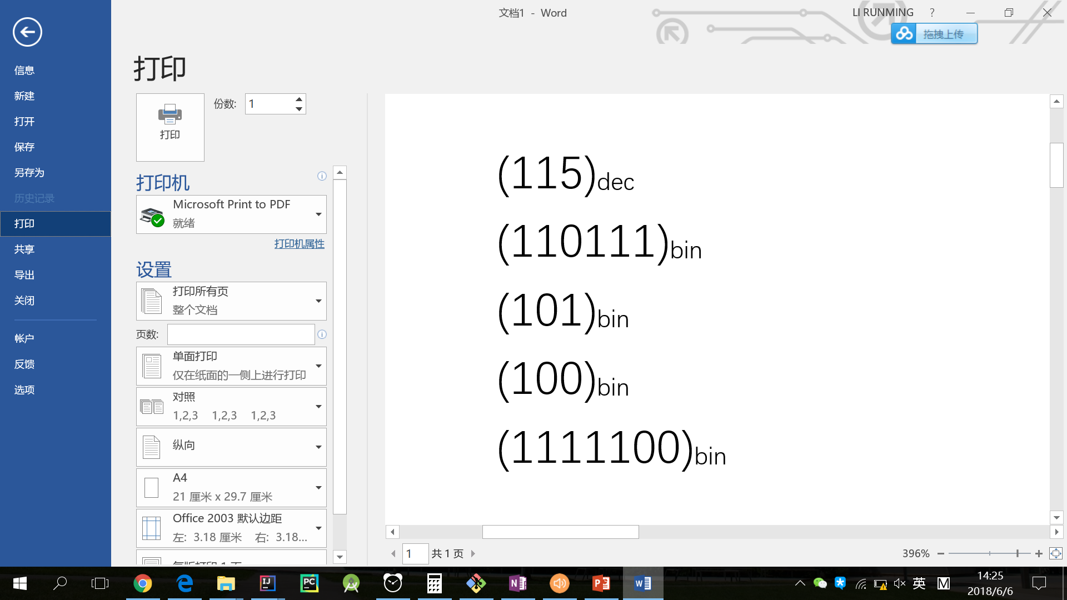
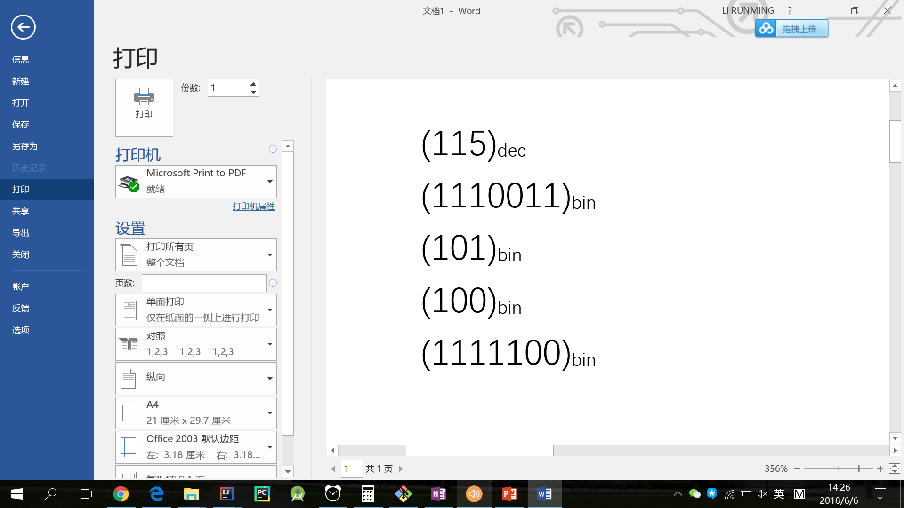
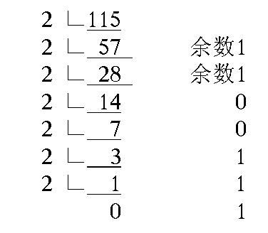
十进制转二进制

Slide 5
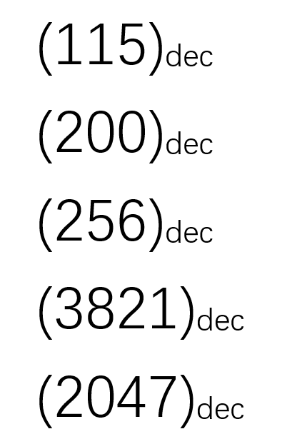
Practice
Notes:
1110011
11001000
100000000
111011101101
11111111111

Slide 6
Bitwise Operation
In digital computer programming, a bitwise operation operates on one or more bit patterns or binary numerals at the level of their individual bits. It is a fast, simple action directly supported by the processor, and is used to manipulate values for comparisons and calculations.
AND, OR, NOT, XOR, SHIFT

Slide 7
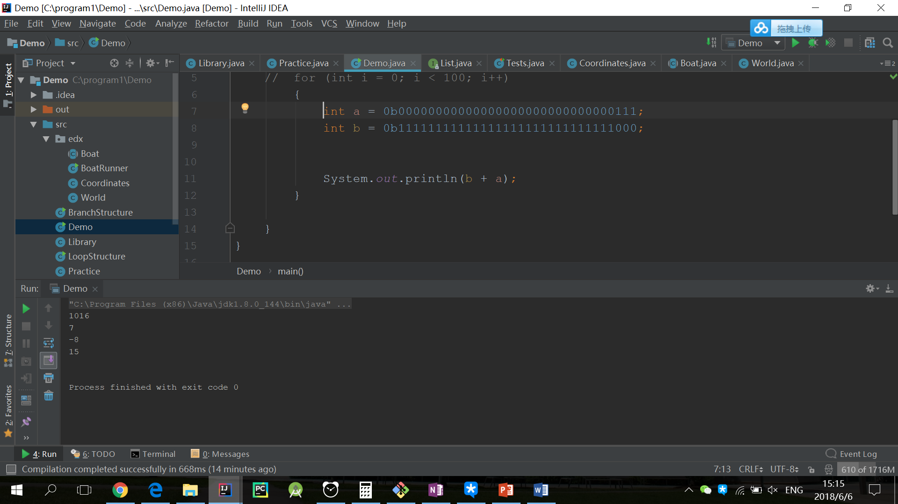
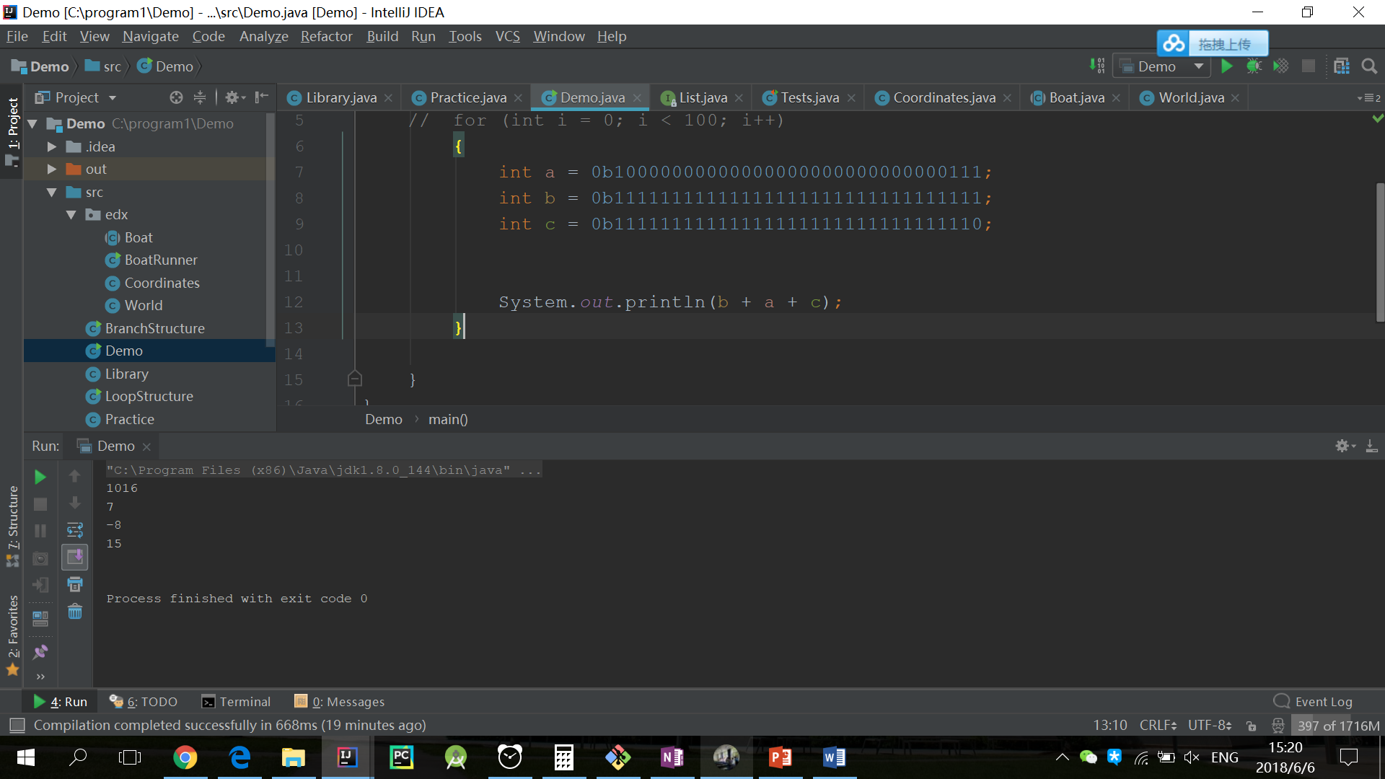
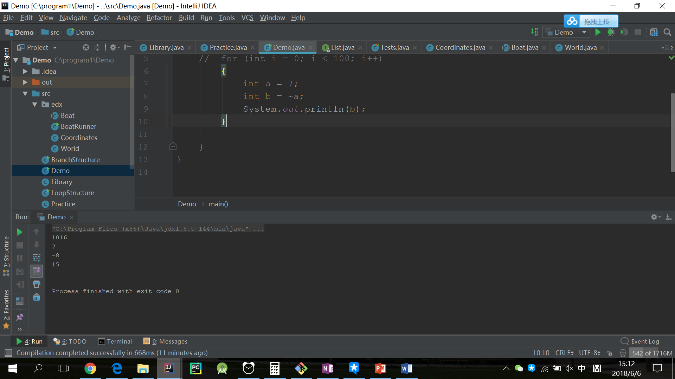

NOT(~)
0111
NOT 1000
NOT x = -x − 1

Slide 8
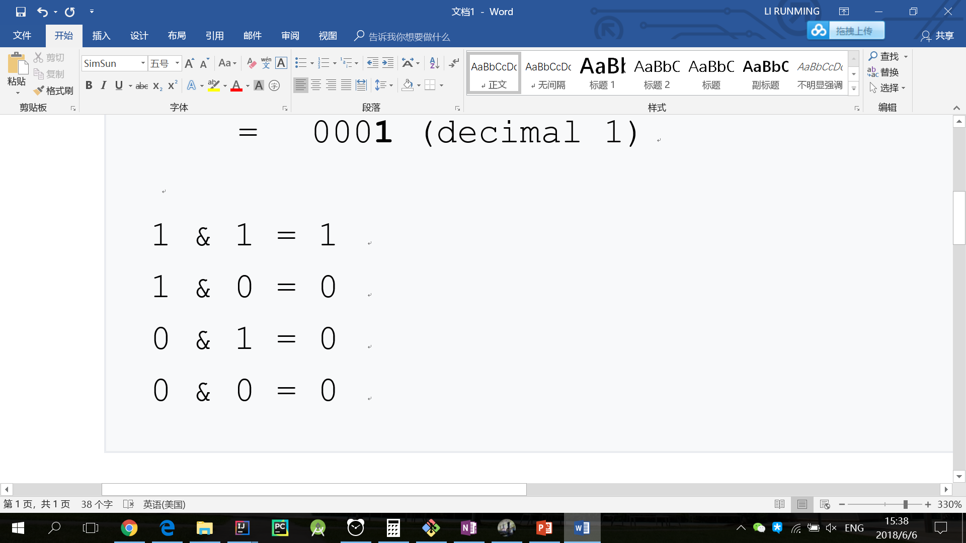
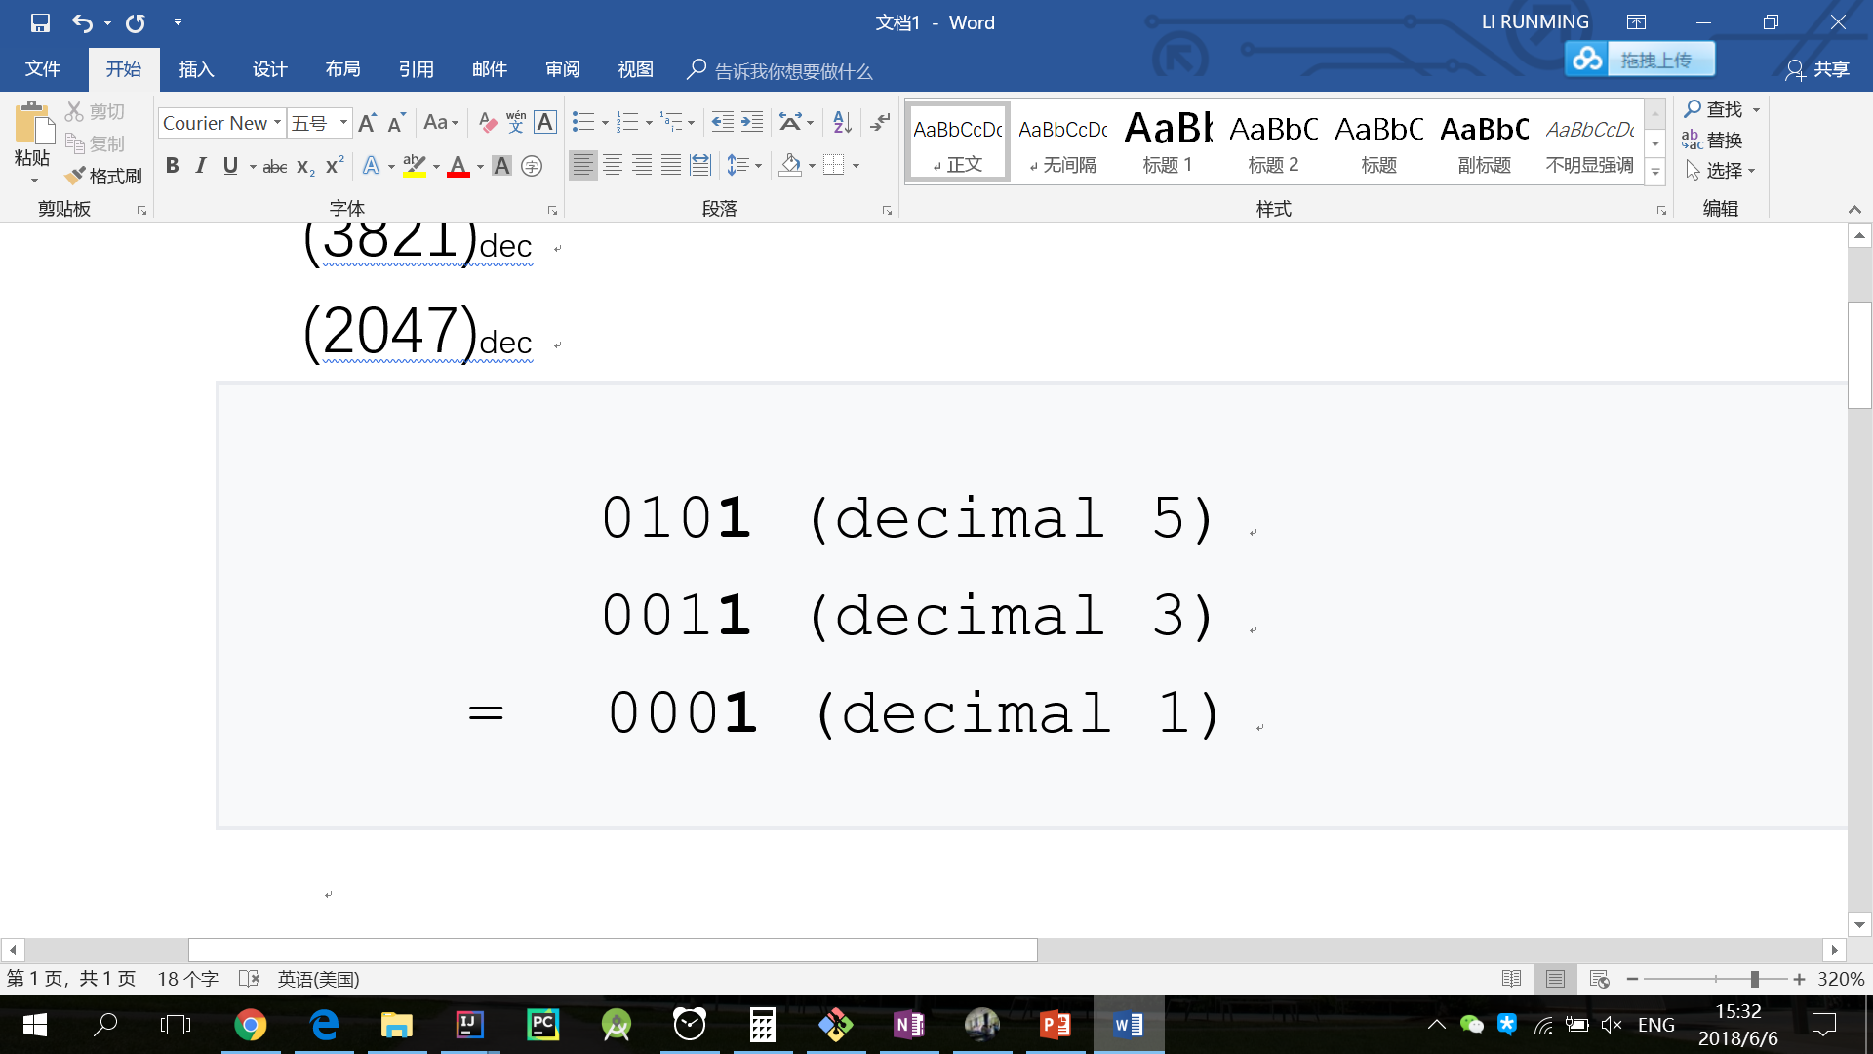
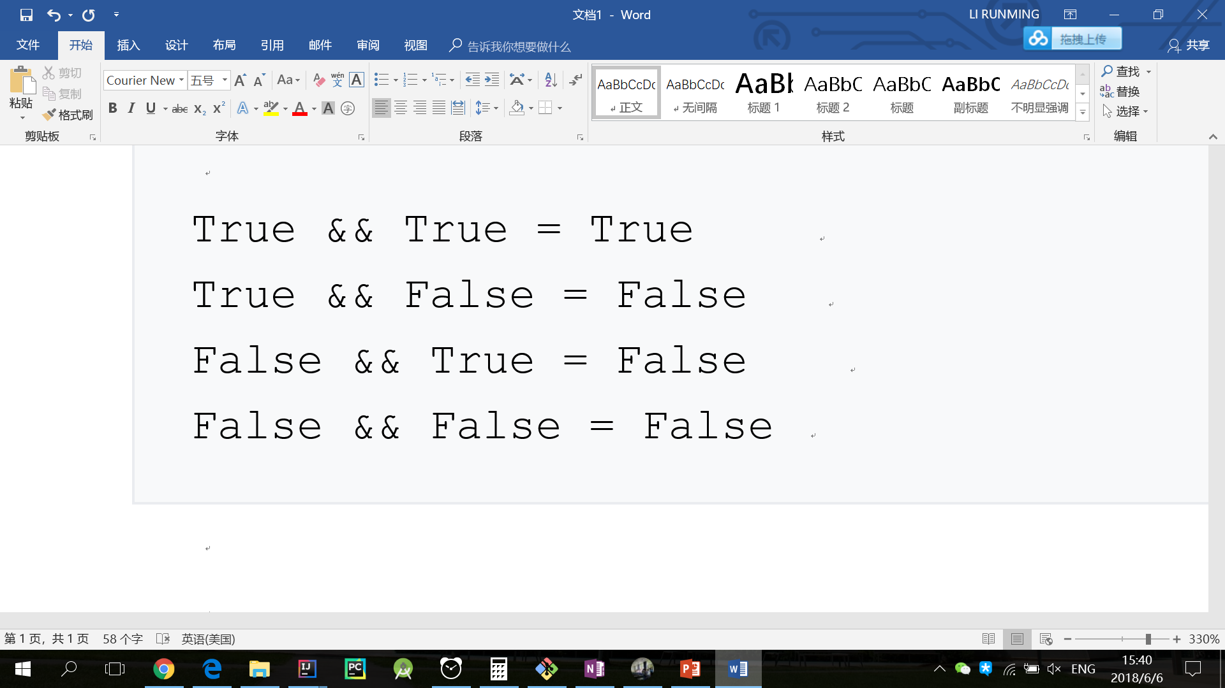
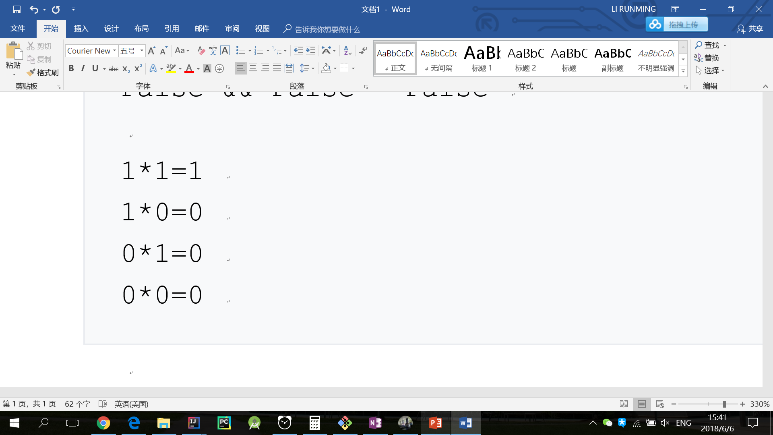
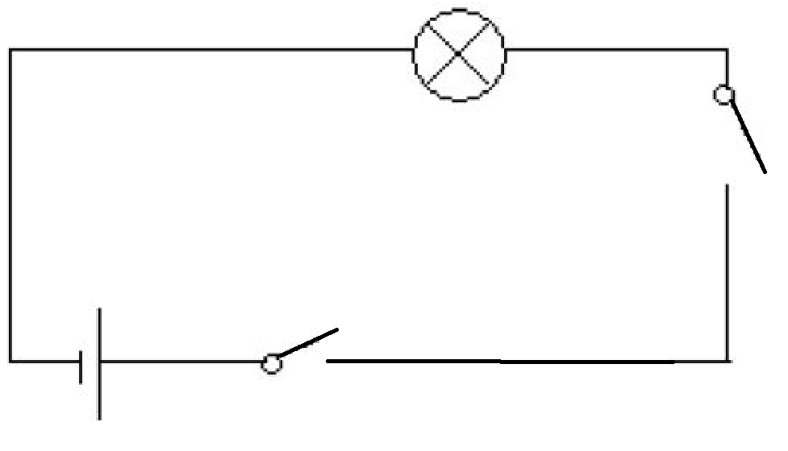
AND(&)
&

Slide 9
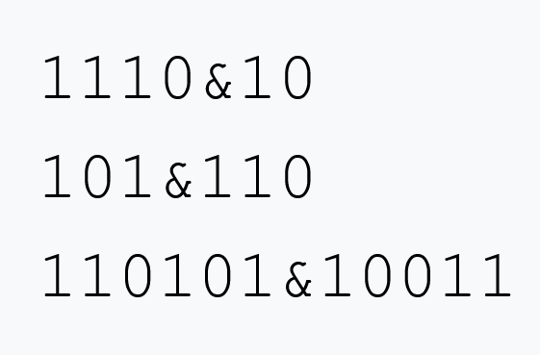
Practice
Notes:
10
100
10001

Slide 10
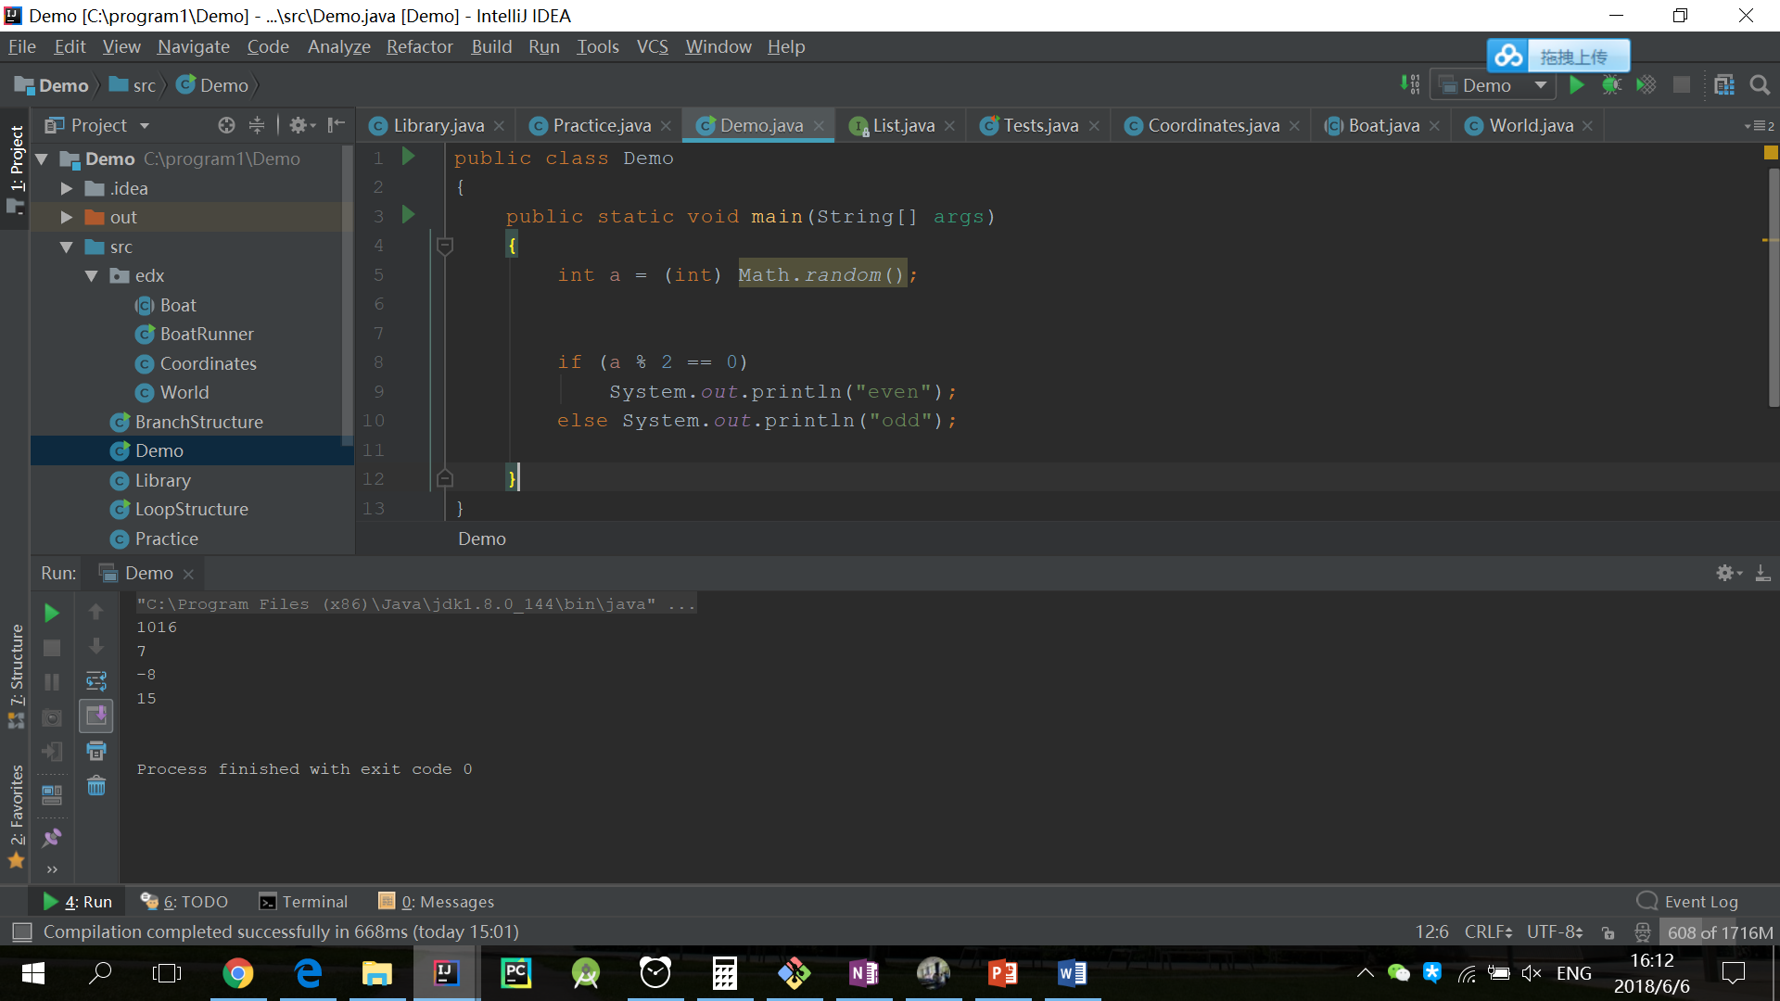

Application
判断一个数是否为偶数

Slide 11
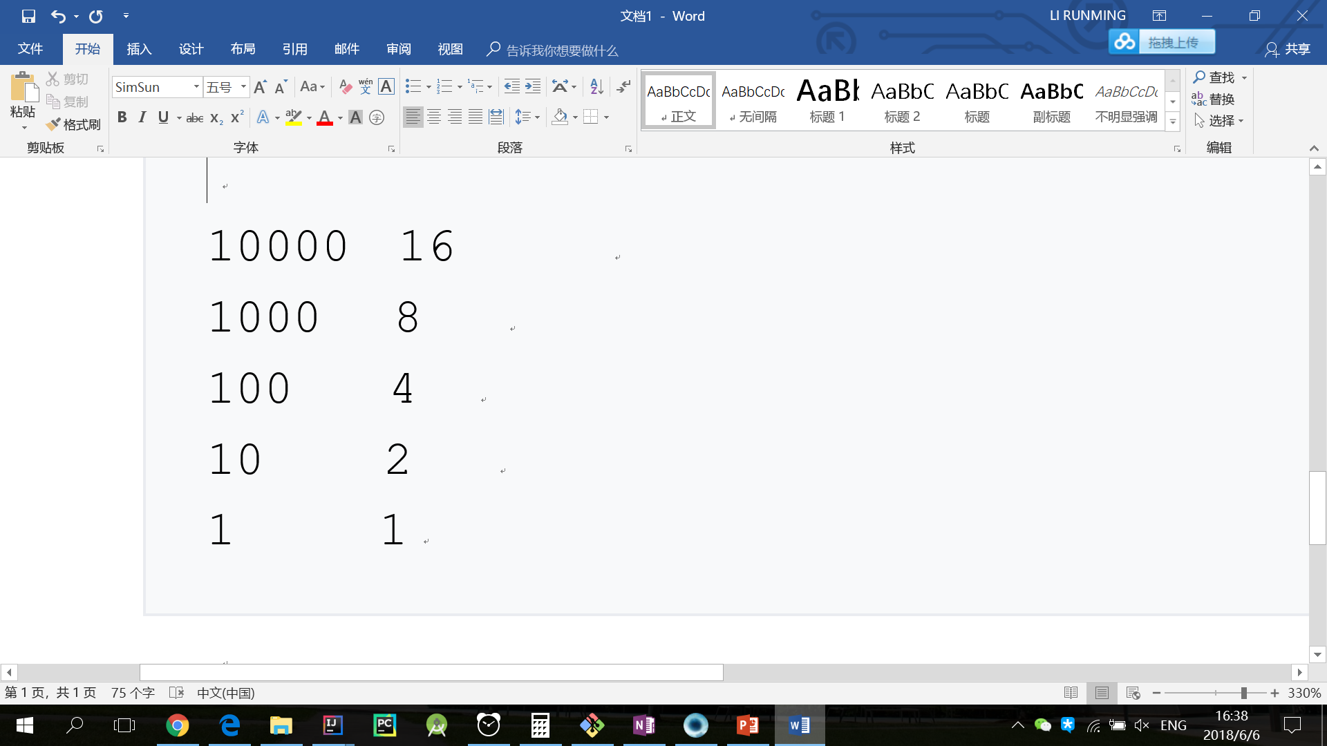
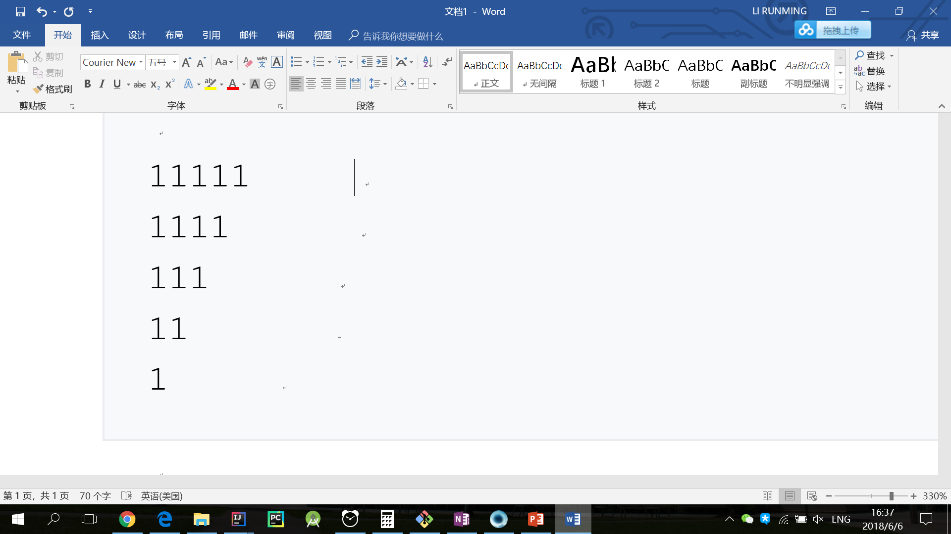
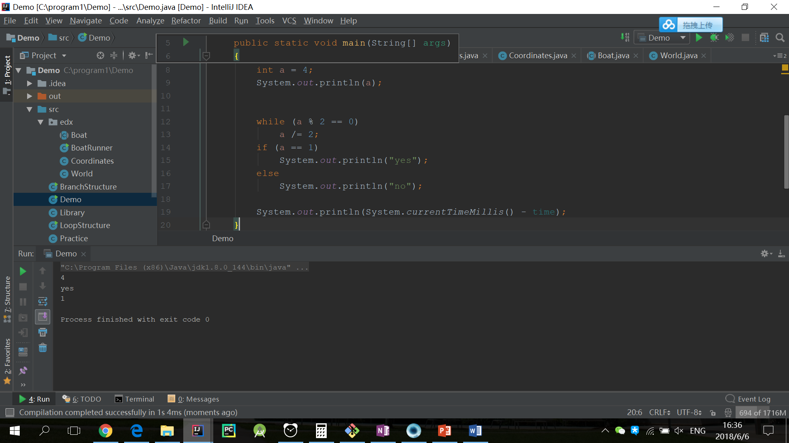
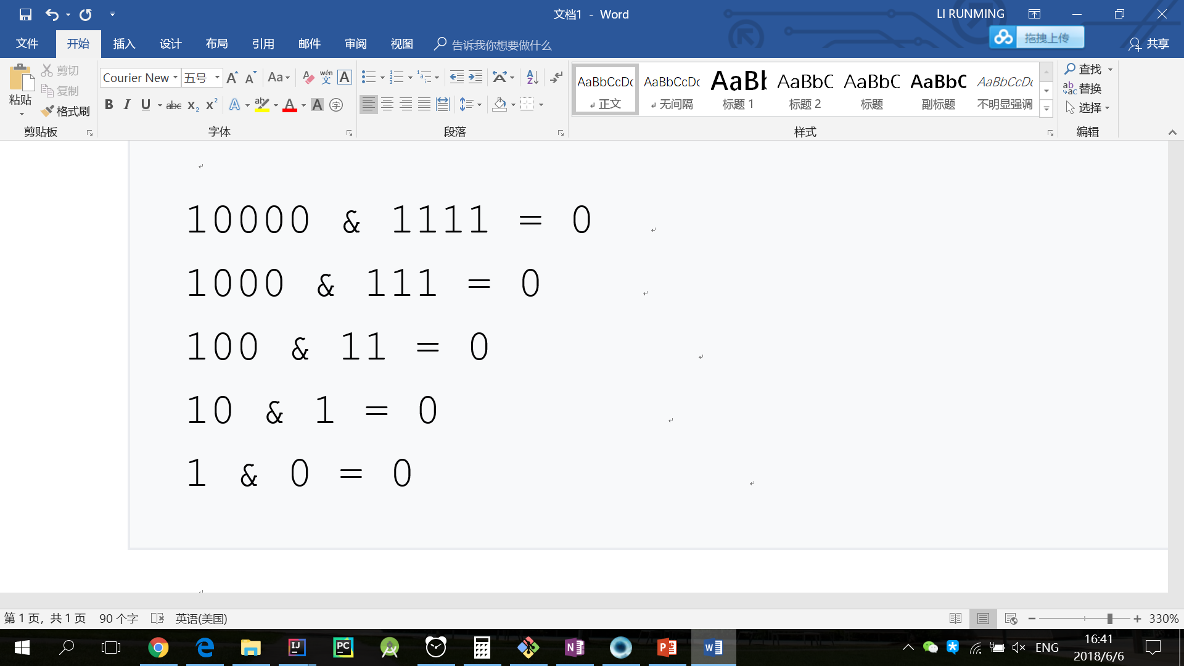
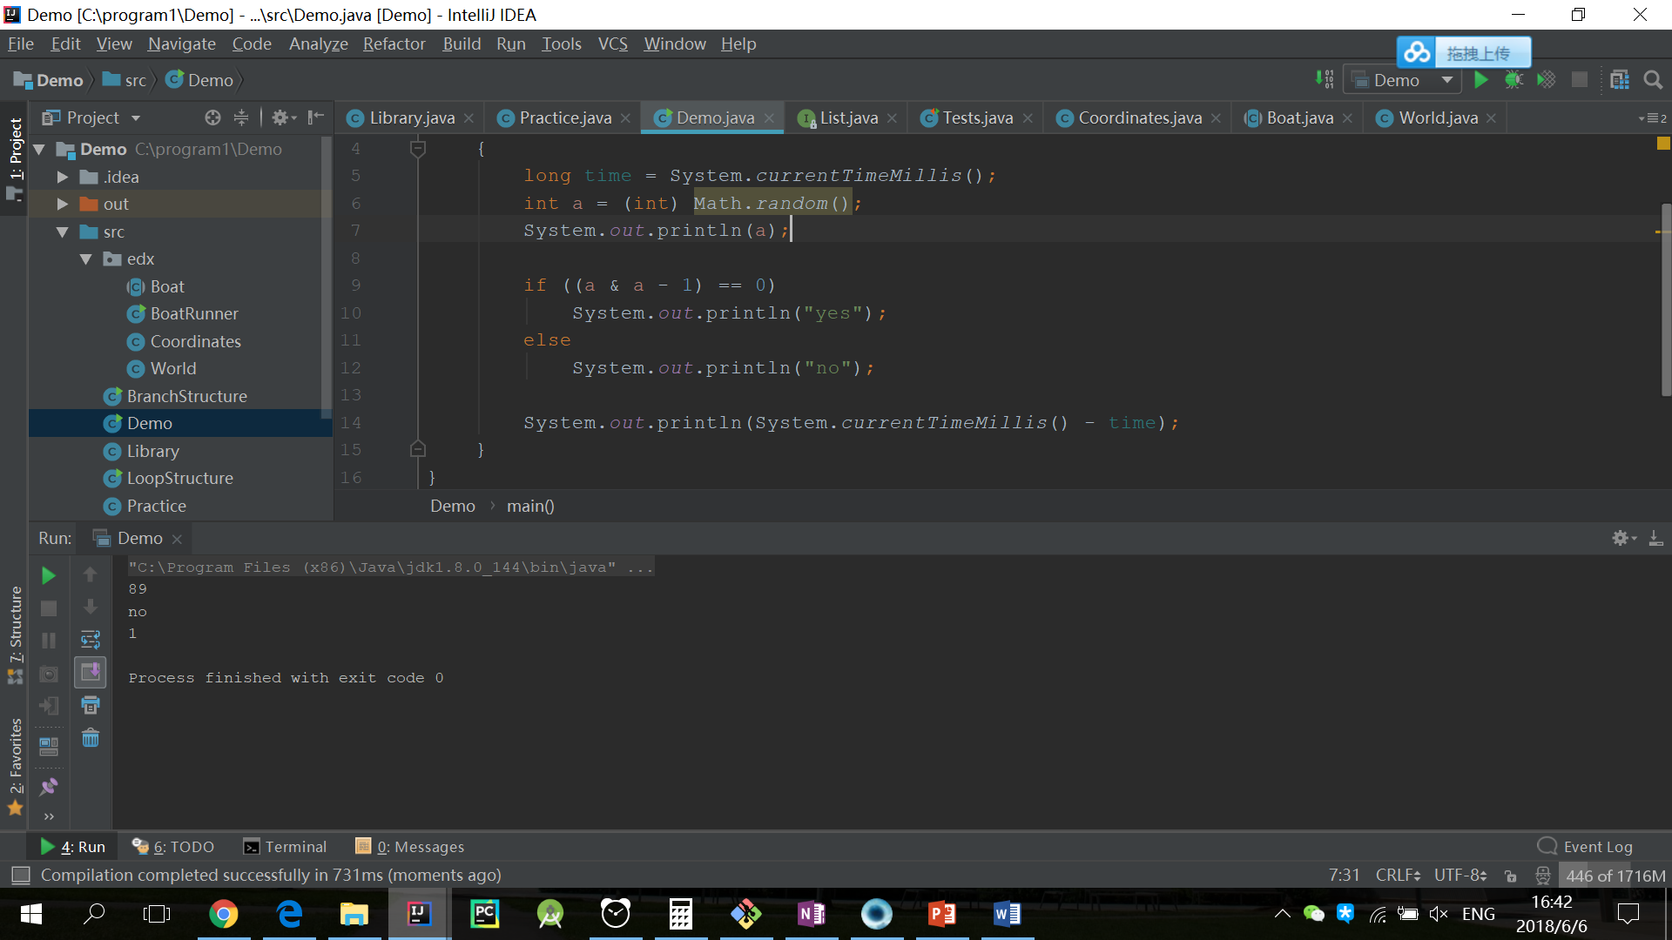
Application
判断一个数是否为2的n次方

Slide 12
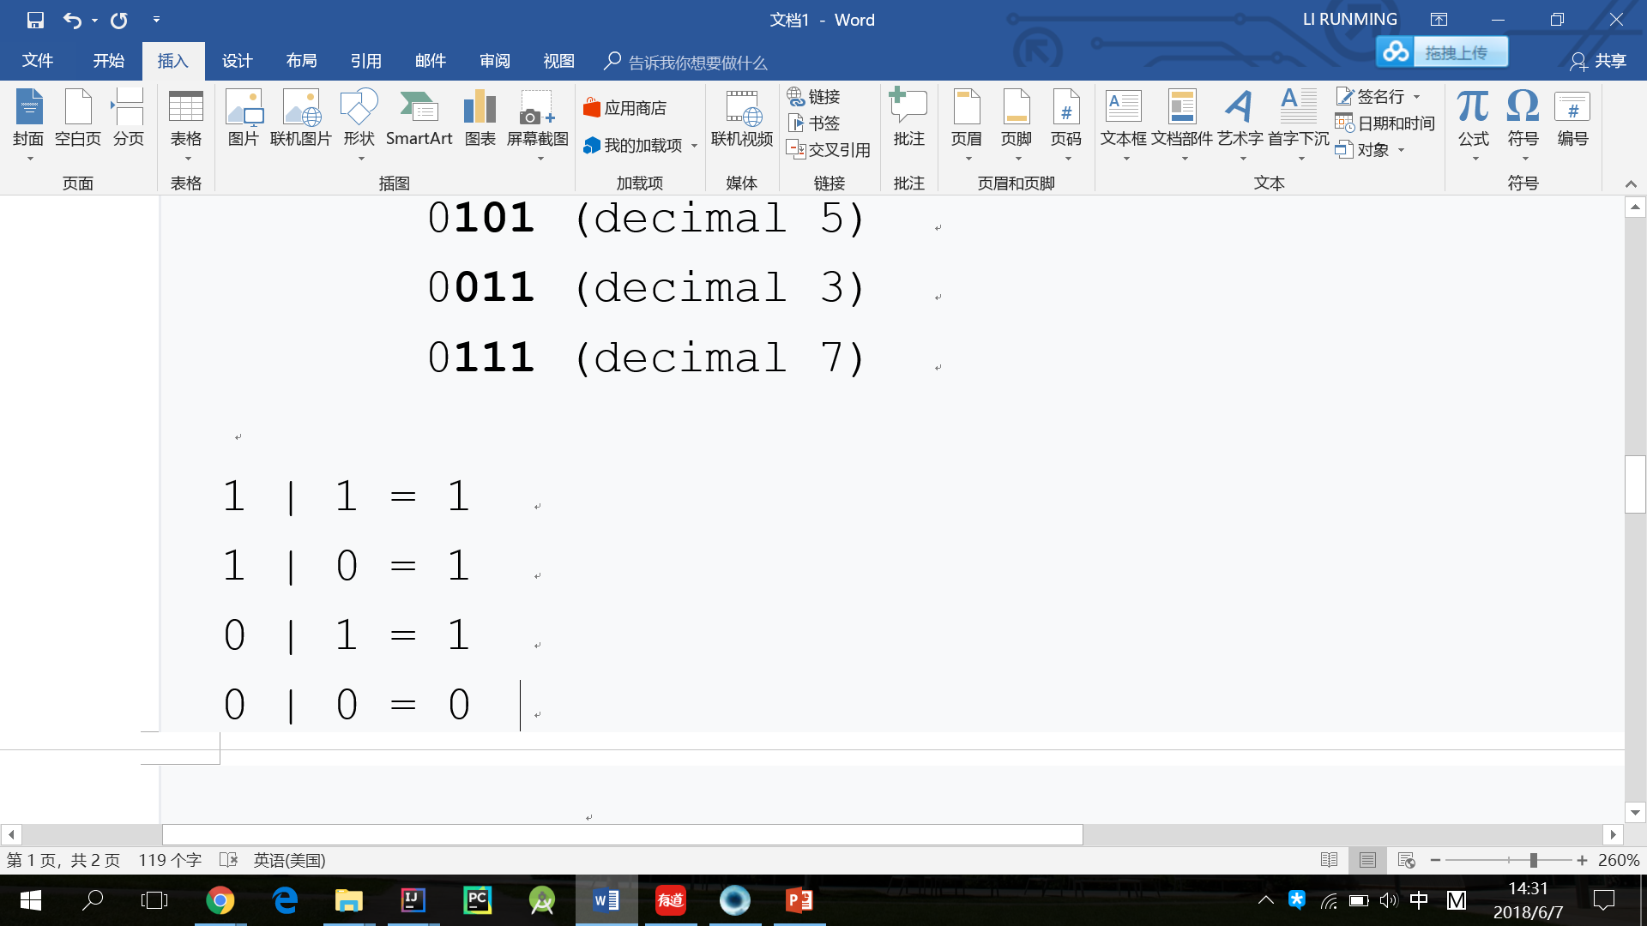
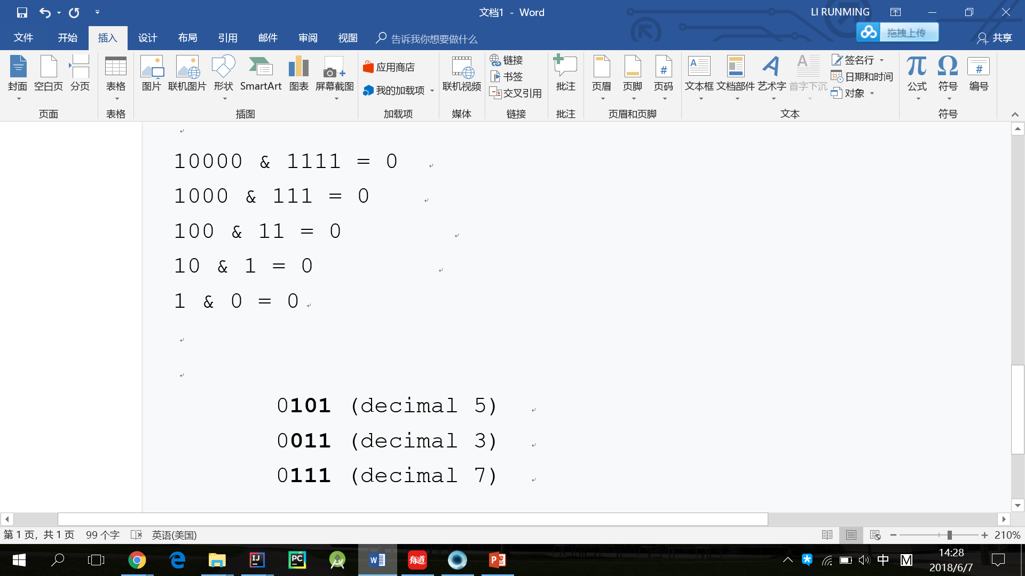
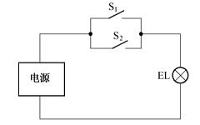
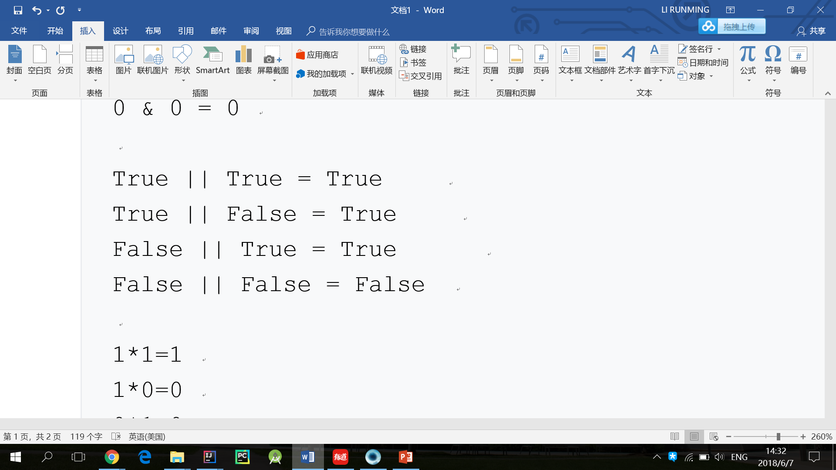
OR(|)
OR
=
Logical inclusive

Slide 13
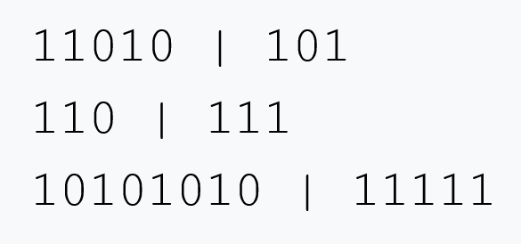
Practice
Notes:
11111
111
10111111

Slide 14
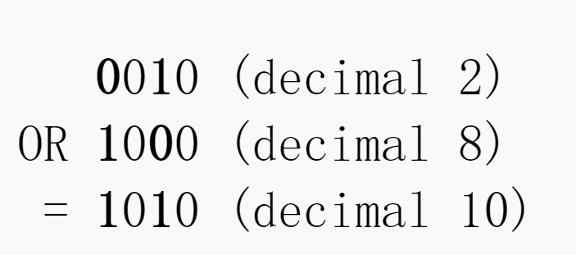
Application

Slide 15
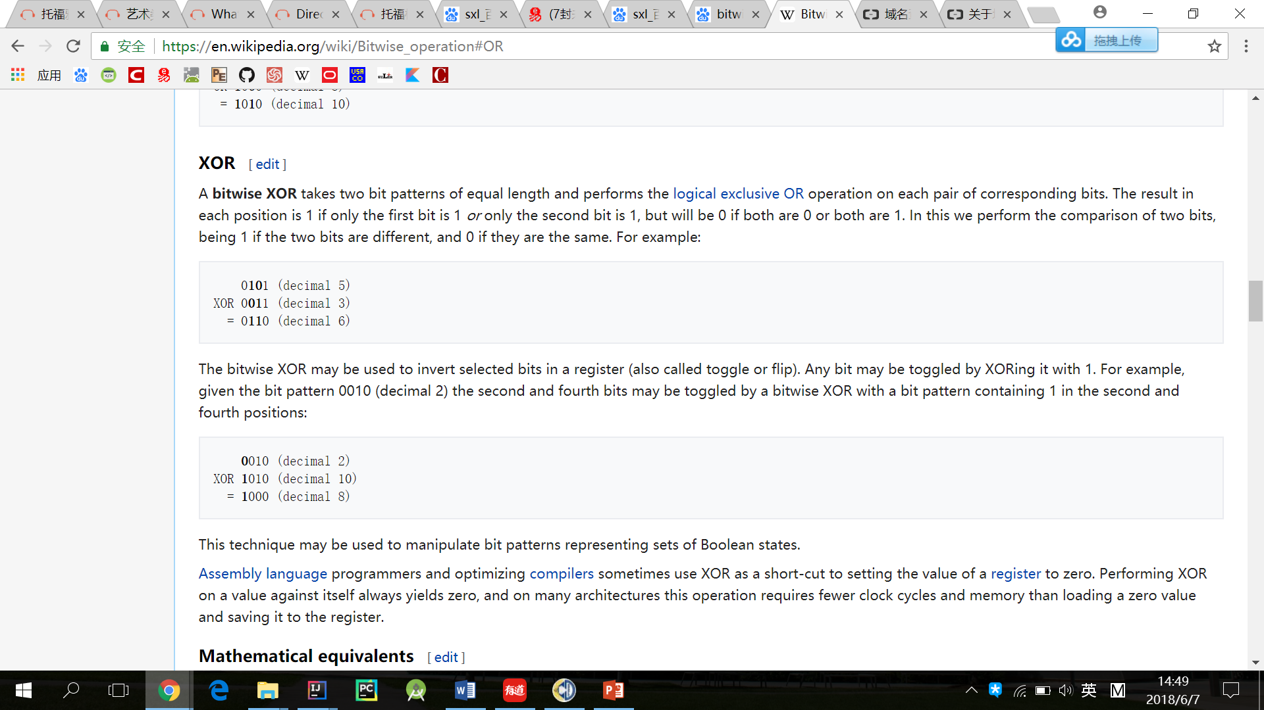
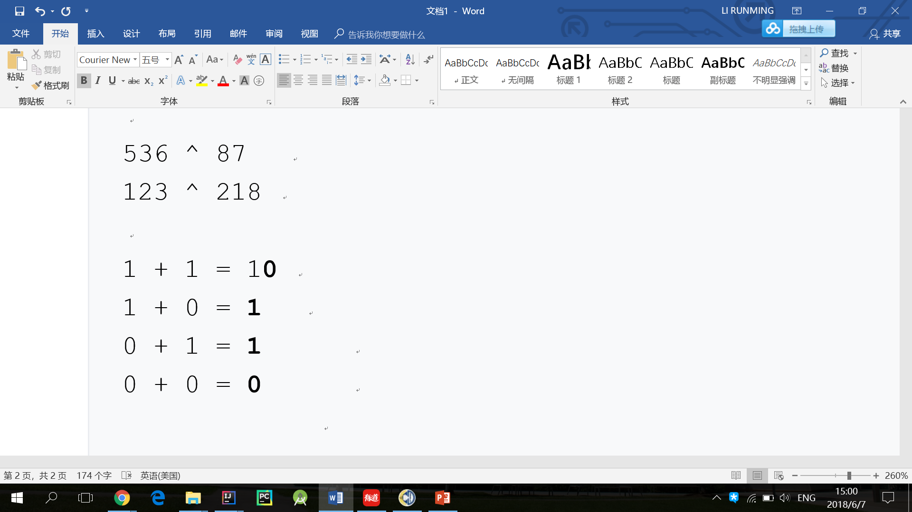
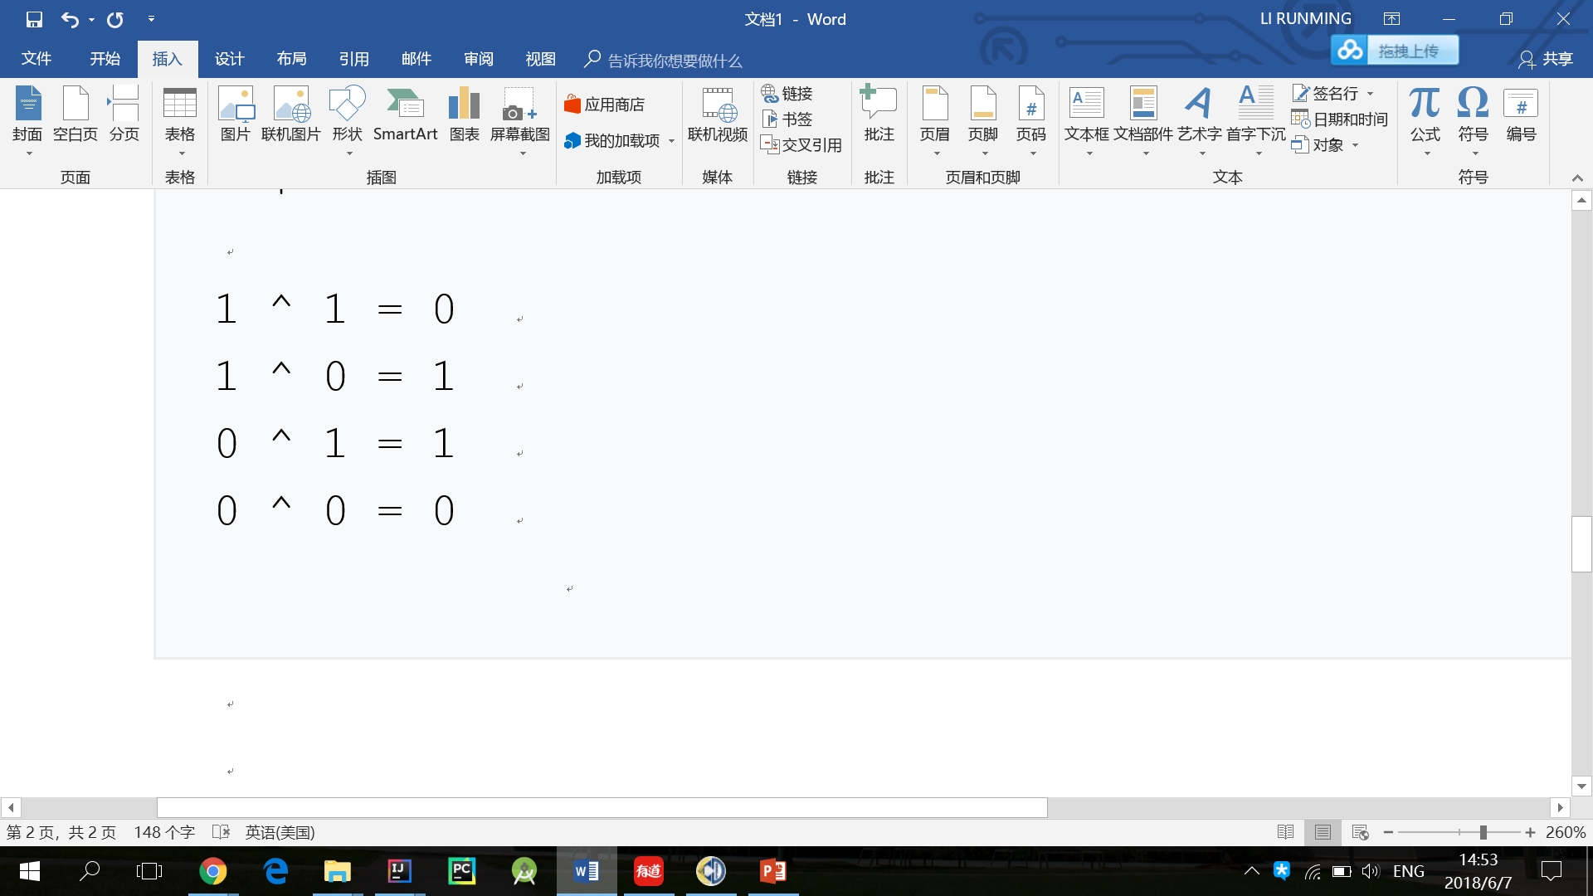
XOR(^)
The result in each position is 1 if only the first bit is 1 or only the second bit is 1, but will be 0 if both are 0 or both are 1.

Slide 16
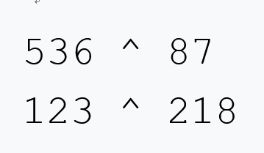
Practice
Notes:
591
161

Slide 17
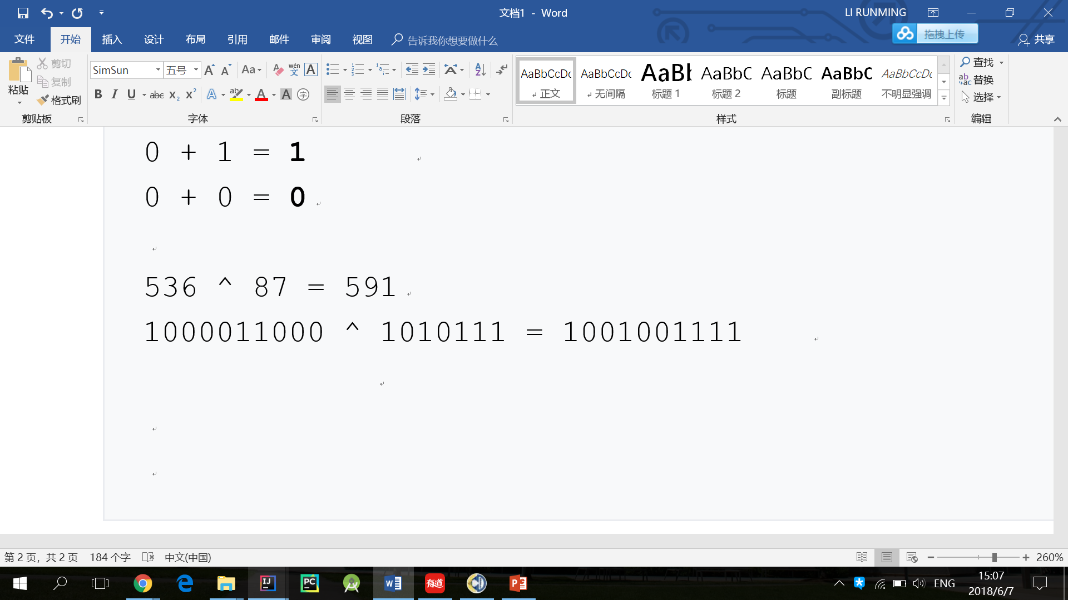
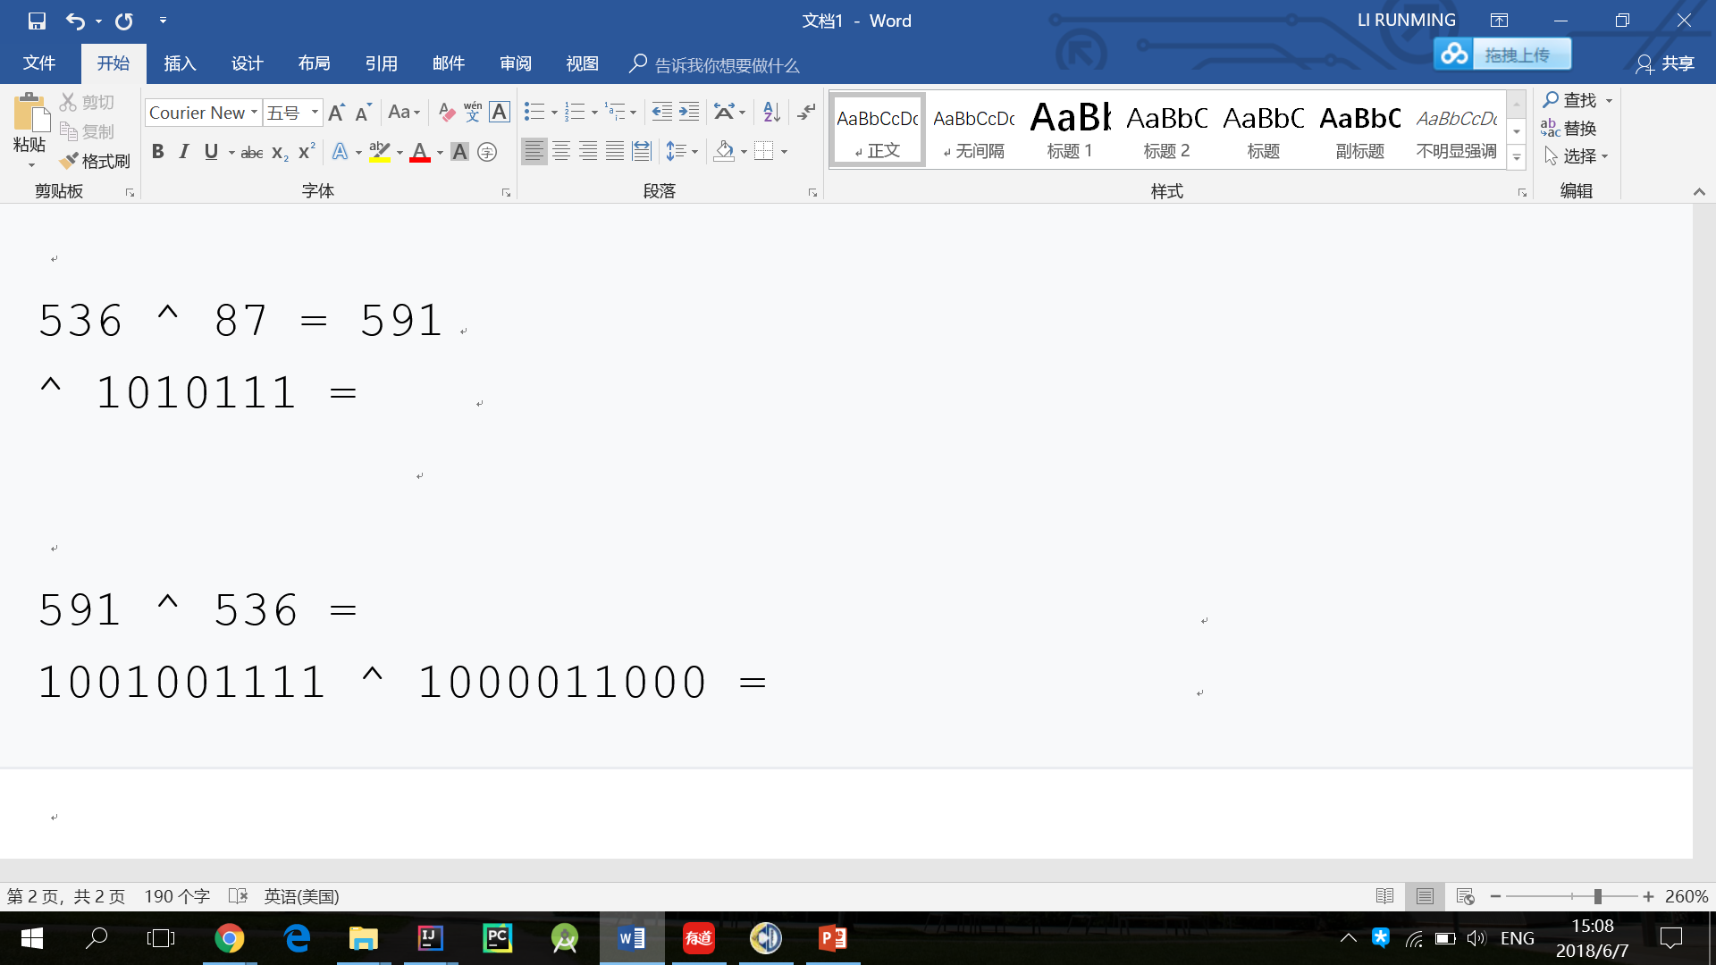
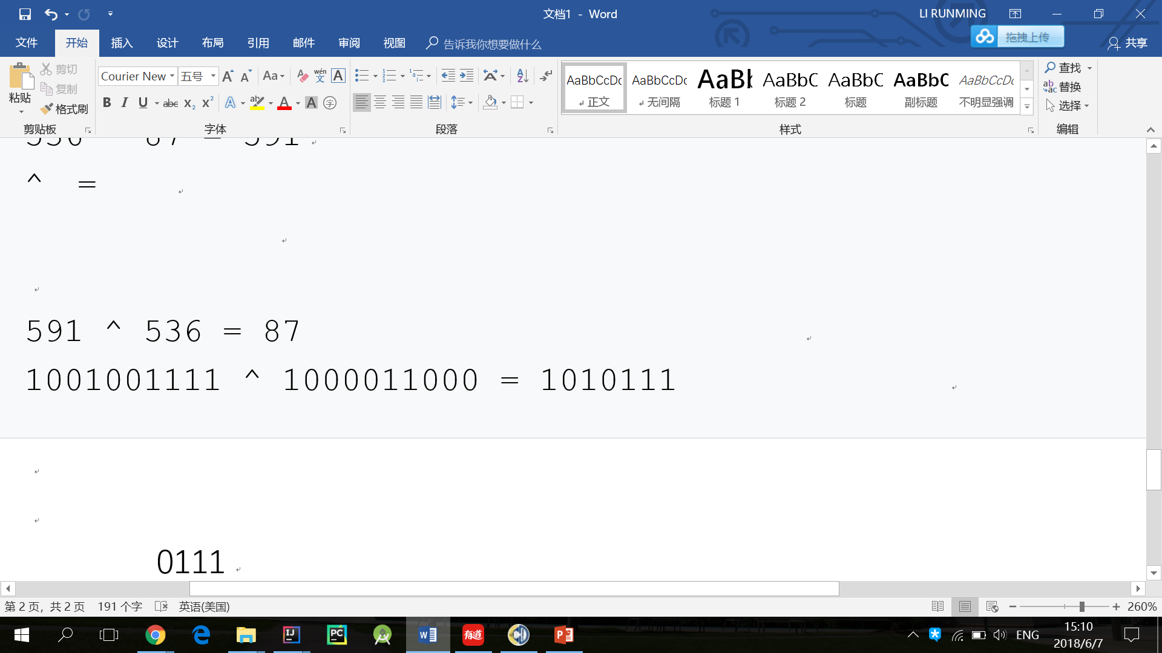
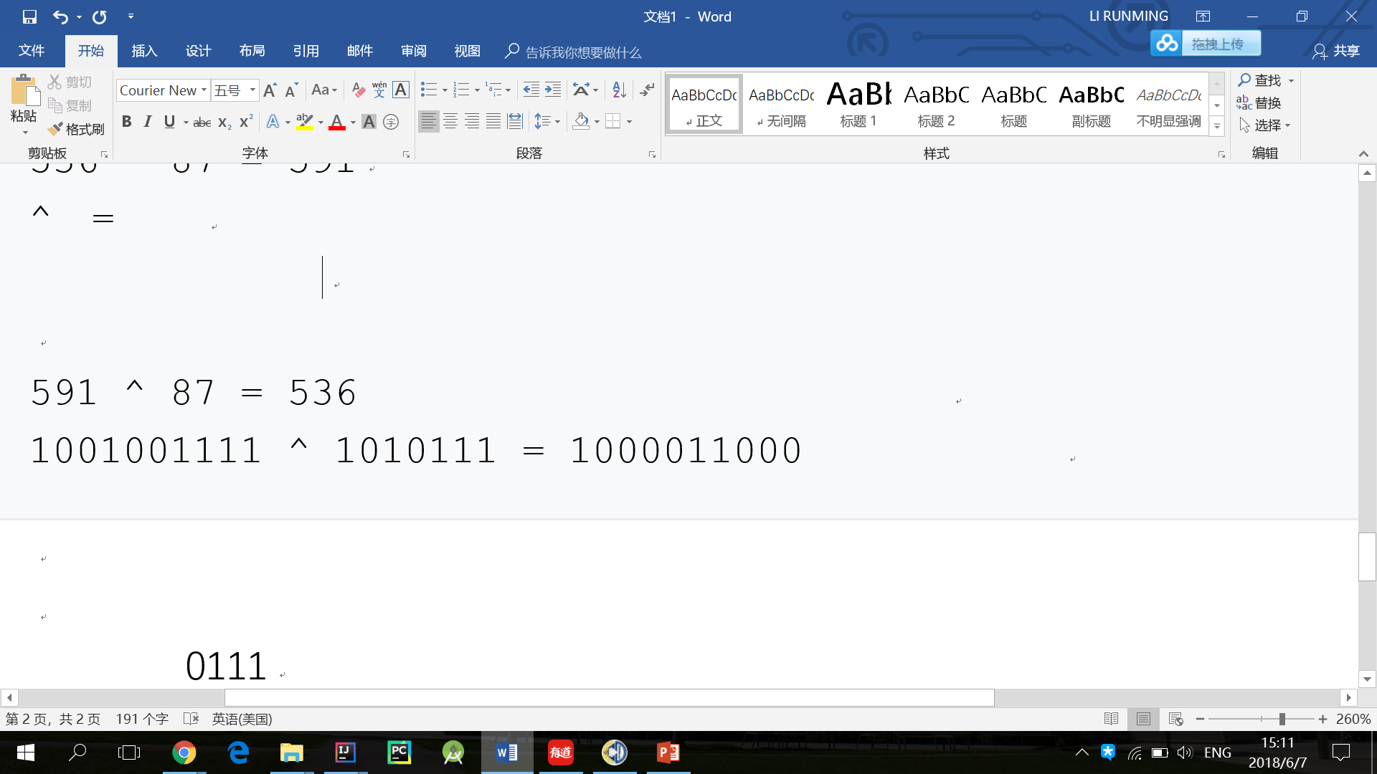
Theorem
a ^ b = b ^ a
a ^ b ^ b = a
a ^ b ^ a = b

Slide 18
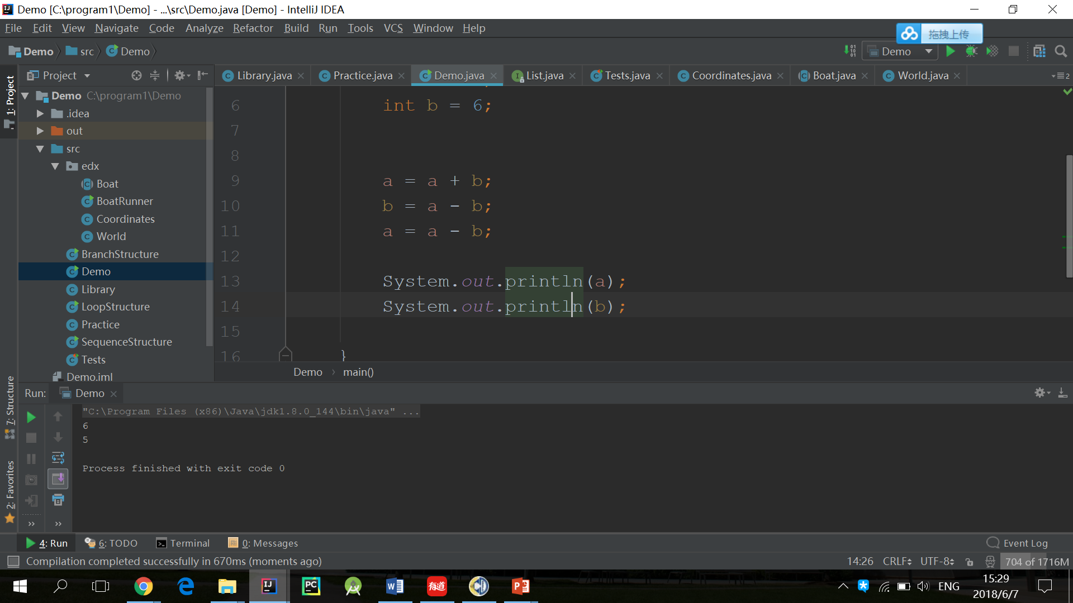
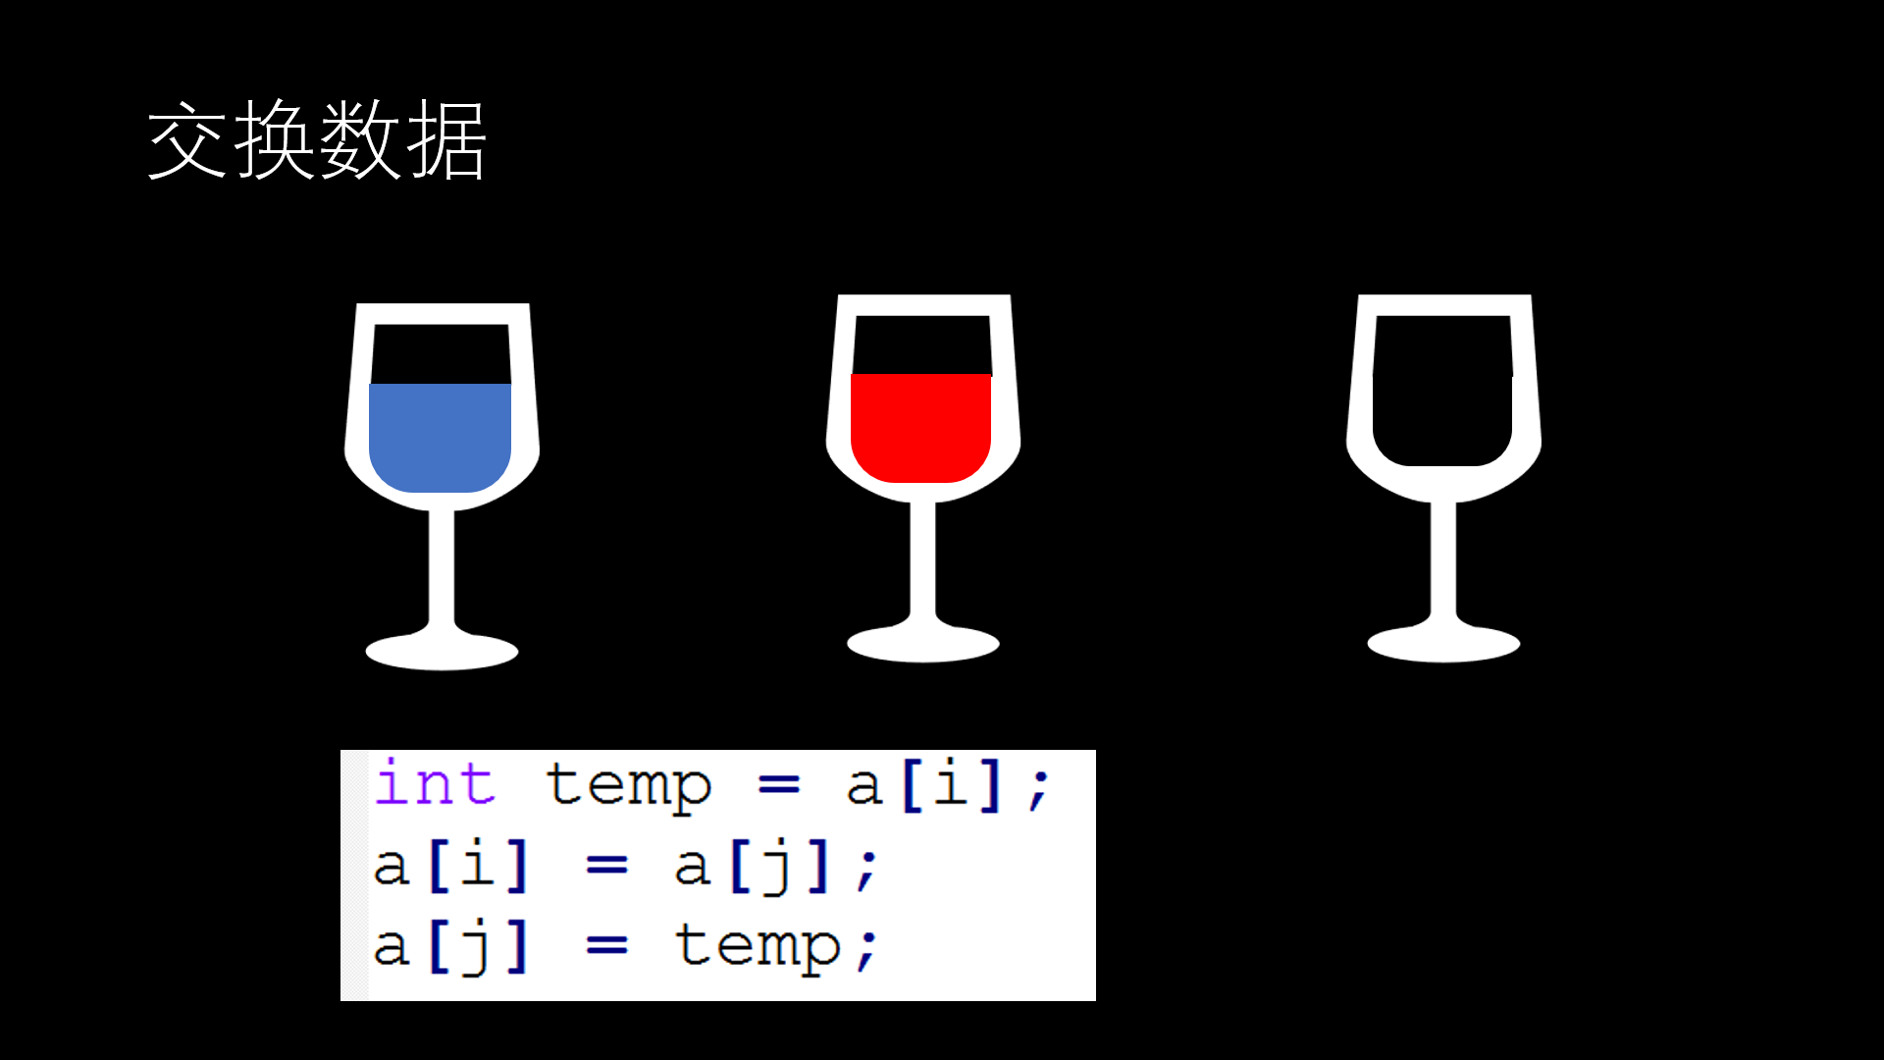
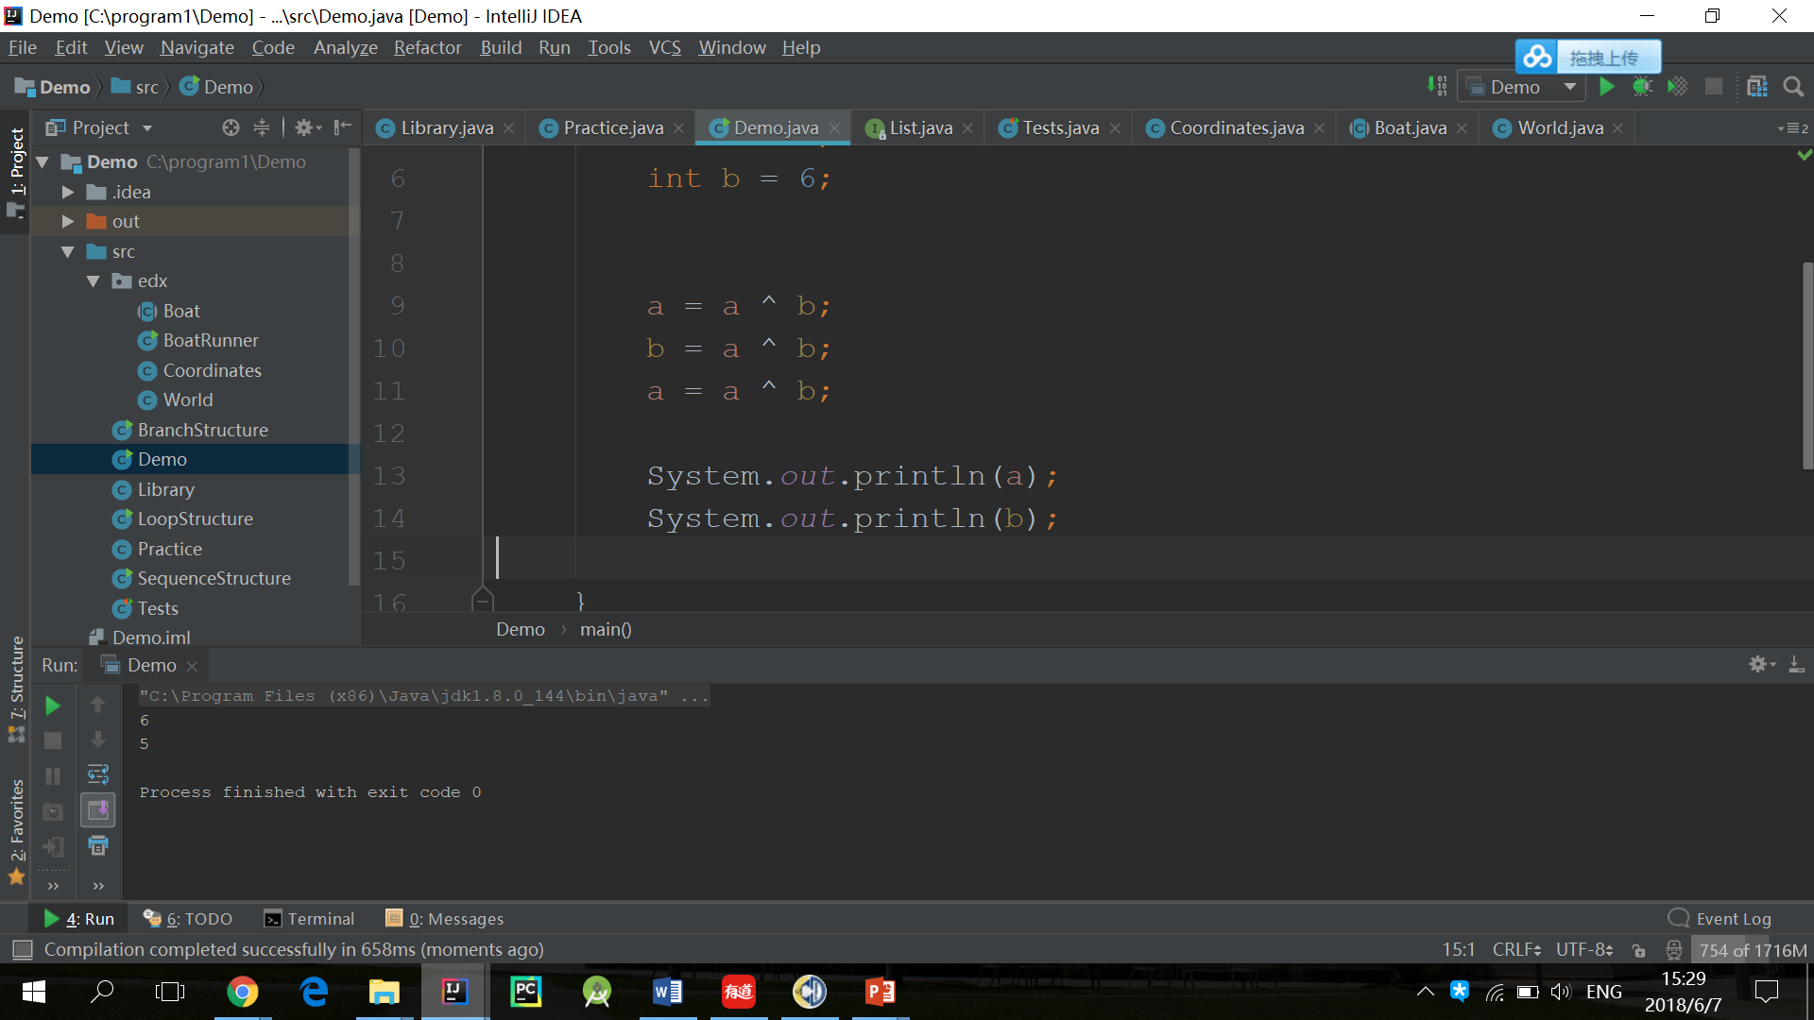
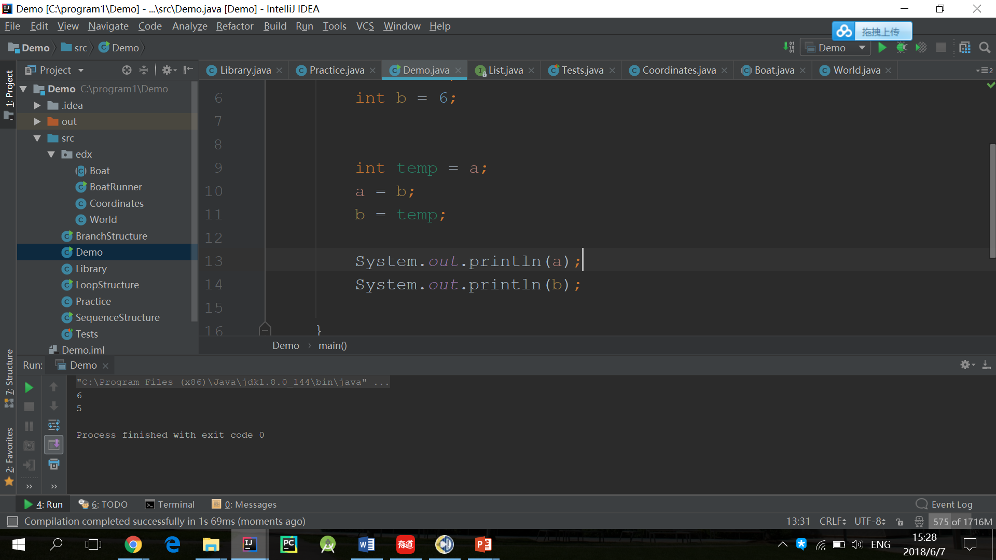
Application

Slide 19
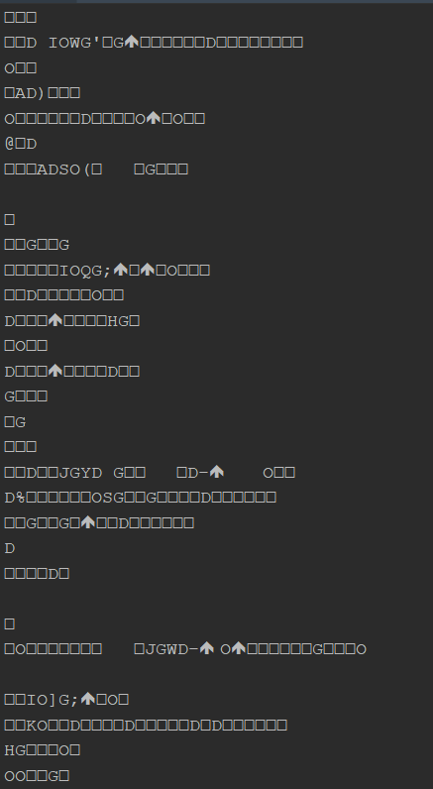
Application
(The Gospel of John, chapter 1) 1 In the beginning the Word already existed. He was with God, and he was God. 2 He was in the beginning with God. 3 He created everything there is. Nothing exists that he didn't make. 4 Life itself was in him, and this life gives light to everyone. 5 The light shines through the darkness, and the darkness can never extinguish it. 6 God sent John the Baptist 7 to tell everyone about the light so that everyone might believe because of his testimony. 8 John himself was not the light; he was only a witness to the light. 9 The one who is the true light, who gives light to everyone, was going to come into the world. 10 But although the world was made through him, the world didn't recognize him when he came. 11 Even in his own land and among his own people, he was not accepted. 12 But to all who believed him and accepted him, he gave the right to become children of God. 13 They are reborn! This is not a physical birth resulting from human passion or plan, this rebirth comes from God.14 So the Word became human and lived here on earth among us. He was full of unfailing love and faithfulness. And we have seen his glory, the glory of the only Son of the Father.

Slide 20
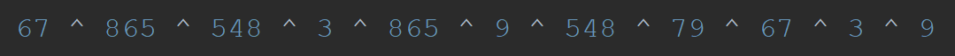
Application
一列数中有一个数出现了一次，其余数均出现了两次，请找出这个之出现了一次的数。
67, 865, 548, 3,865, 9, 548, 79, 67, 3, 9
= 79

Slide 21
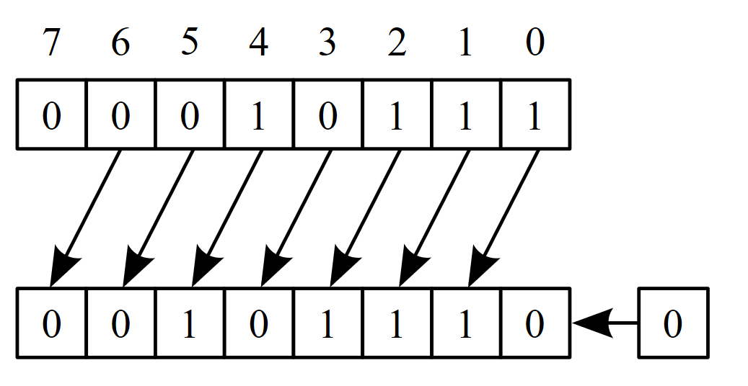
LEFT-SHIFT(<<)
Left-shift <<
10111 << 1
= 101110
23 << 1 = 46
10111 << 2
= 1011100
23 << 2 = 92
a << n = a * 2^{n}

Slide 22
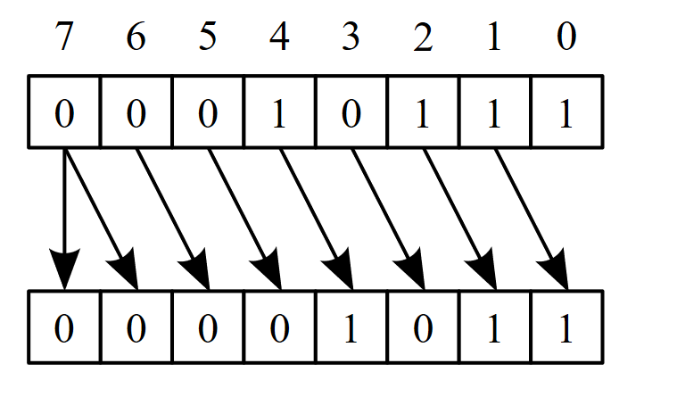
RIGHT-SHIFT(>>)
Right-shift >>
10111 >> 1
= 1011
23 >> 1 = 11
10111 >> 2
= 101
23 >> 3 = 5
a >> n = a / 2^{n}

Slide 23
小结
NOT
AND
OR
XOR
SHIFT

Slide 24

Thanks for listening
This work is licensed under a Creative Commons Attribution-NonCommercial-NoDerivs 2.0 Generic License.

